Slide 1
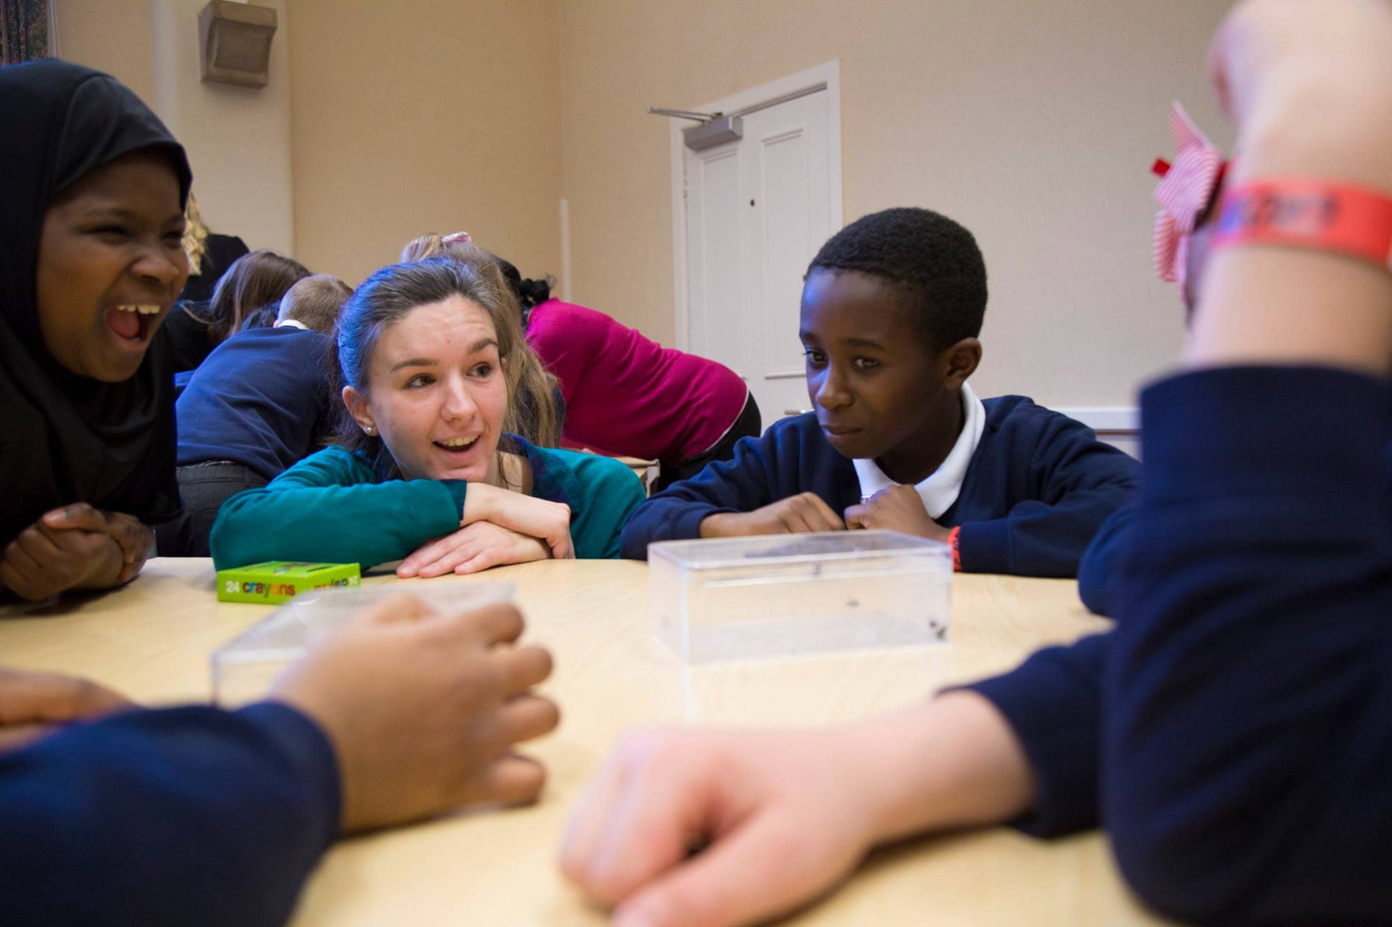
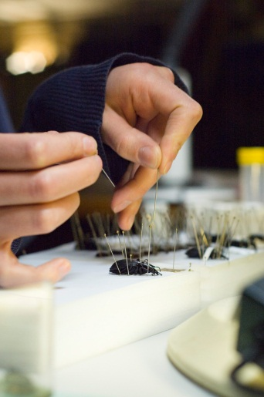
Science Communication for insects
Francisca Sconce
fran@royensoc.co.uk
@FranciscaSconce
www.royensoc.co.uk

Slide 2
What is… ?
Science communication
Public engagement
Outreach

Slide 3
From BIG STEM Communicators network…
“Science Communication is the practise of communicating science-related topics to non-experts.”
“Public engagement aims to engage the general public in two-way scientific conversations, usually about shared issues and problems, to hopefully benefit society as a whole.”
Outreach activities are usually seen as public activities, to encourage the public understanding of science and scientific research, often encourage STEM study in higher education, or to support more formal education.

Slide 4
Public understanding of insects
We are aware of:
Insect decline
Ecosystem services
Disease vectors
Economic pests
See RES Grand Challenges.
Often the conversation is actually:
What is it?
Does it bite/sting/hurt/kill me?
Why is it like that?
How does it live?
What do you do?
Why do you do it?
How do you do it?
How much does it cost?
What would happen if you didn’t do it?
How do “we” benefit?

Slide 5
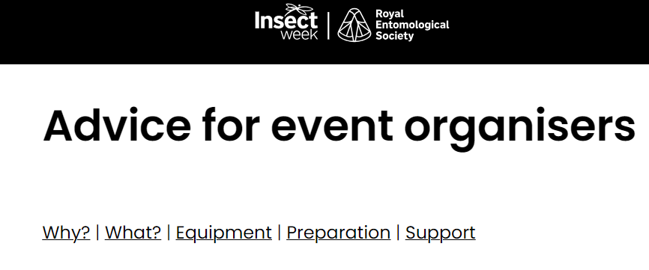
Planning
Focus on the take home message/behaviour change that you want participants to remember
Plan your activities backwards from with aims in mind.
Ideally incorporate evaluation linked to the aims, pre and post intervention.

Slide 6
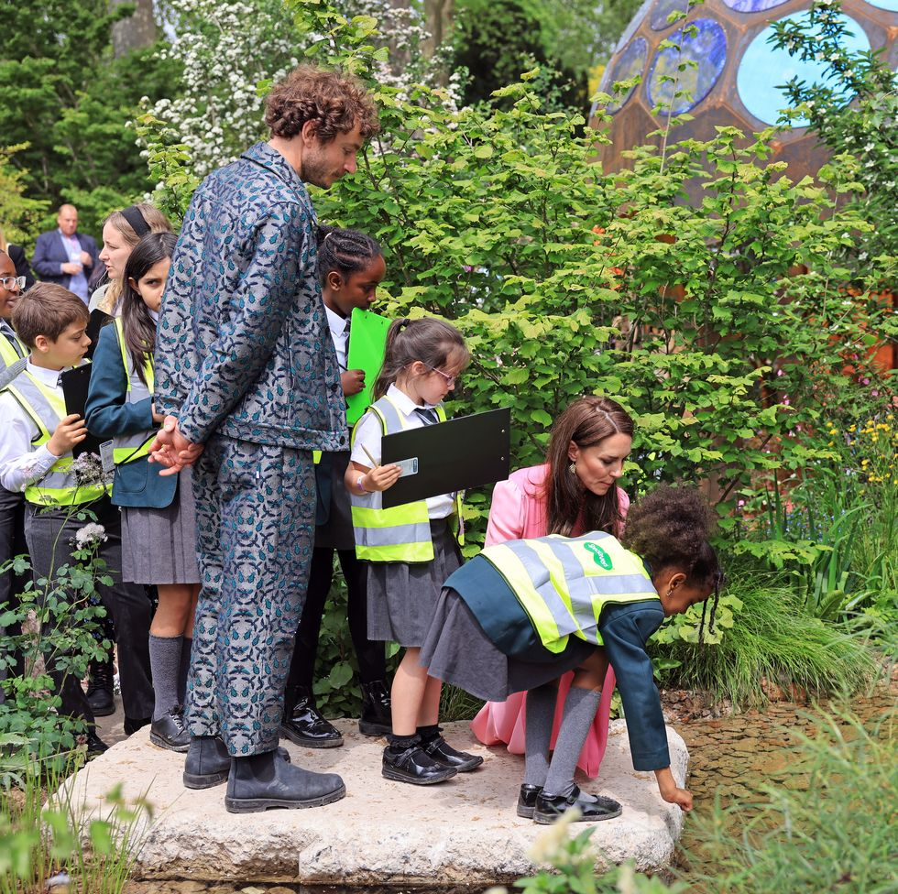
Audiences
Age
Education background
Cultural experience
Special educational needs
Sensory and communication issues
Socio-economic status
Decision makers/Policy makers

Slide 7
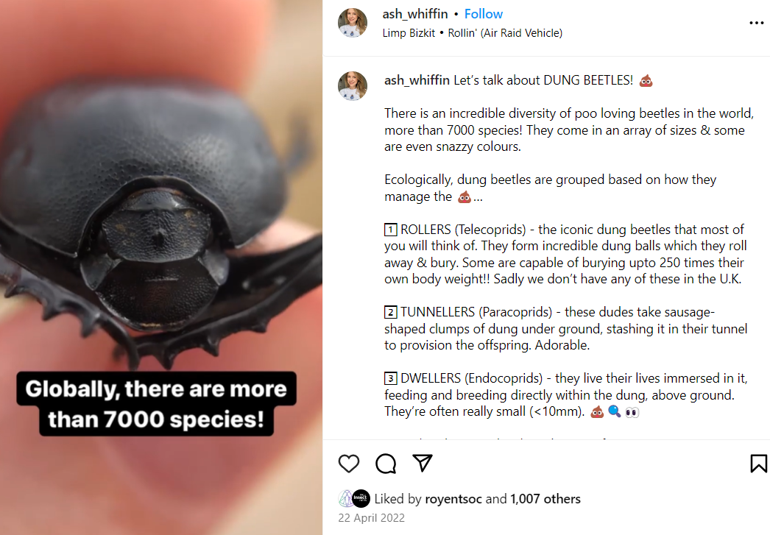

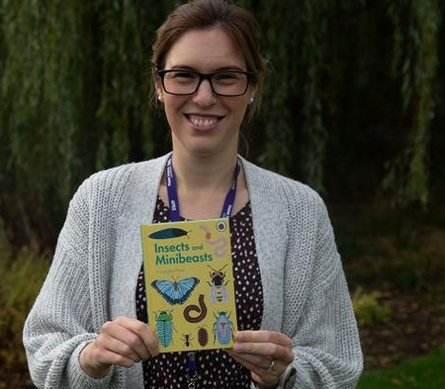
Modes of delivery
Talks
Books
Video
Social media
Interactive stand
Classroom session
Games
Videos
Citizen or Community science
Arts related

Slide 8
Publicising research in the media
Graphical abstracts and lay summaries can broaden audience.
Social media posts can increase altmetrics.
Good images are helpful for all platforms.
Work on press release with your institution press office (& journal staff.)
For interviews, ideally have training and practice with a non-expert.
Be clear on the main points of your take home message.

Slide 9
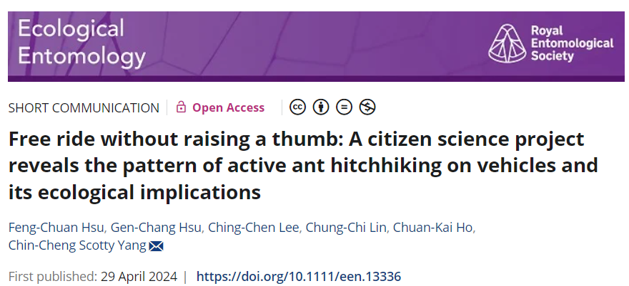
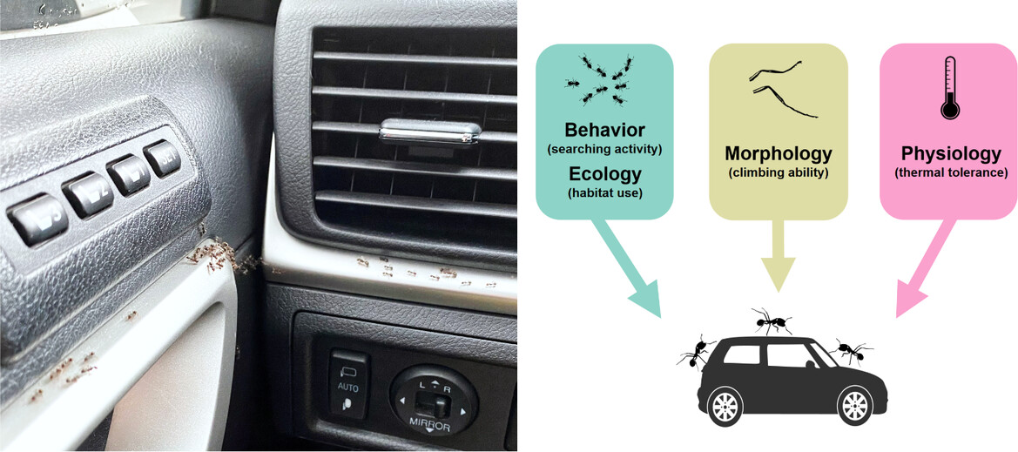
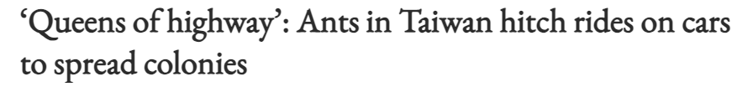
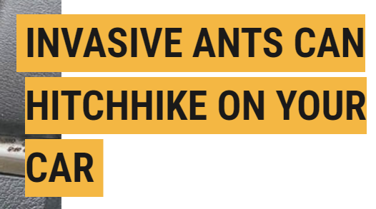
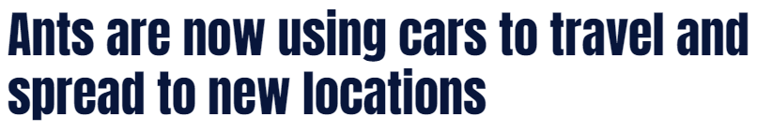
Example

Slide 10



Things to try
Summarise your research for:
a 10 year old, 16 year old, 60 year old…
(and what about other audiences?)
Contact your Institution’s outreach team
Look into:
STEM Ambassadors,
Brilliant Club
Frontiers for Young Minds
NCCPE
Big STEM Communicators Network

Slide 11
Thank you
Francisca Sconce
fran@royensoc.co.uk
@FranciscaSconce
www.royensoc.co.uk

